Slide 1
Balancing Power: EU Economic Security and International Trade
Webinar: The New Strategy for Economic Security of the EU Trade Policy - First Steps and Implications in International Law
Università di Bologna, Re-Globe Jean Monnet Module
07 February 2025
Lukas Schaupp

Slide 2
Today, I’ll be talking about…
… the EU’s emerging security paradigm
… the context and content of the Economic Security Strategy
… the internal and external dimension of the Strategy
… why I think that the external one matters more (trade!)
… and what all this could mean for international economic law

Slide 3

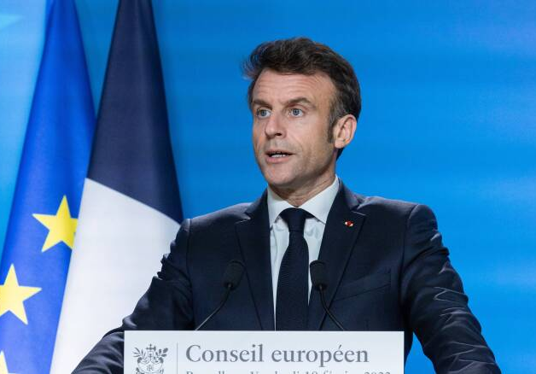
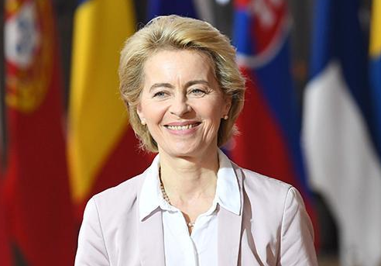
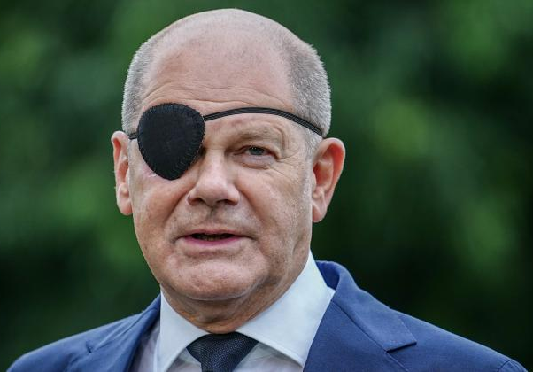
Towards a security paradigm in the EU?
Autonomie stratégique
Age of geostrategic
rivalries
Zeiten-wende
Strategic and assertive foreign and security policy

Slide 4
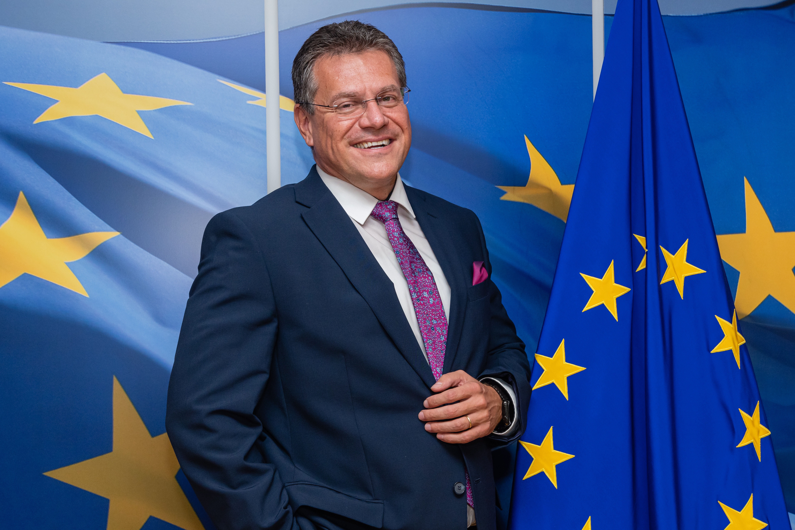
Economic security: the state strikes back
Departure from Neoliberal Era and a return of state intervention
Geopolitical challenges drive activist forms of governance in Europe and elsewhere
Emerging security paradigm among sectors that underwent integration
Notes:
Short recap of what I mean by this “shift towards security-oriented thinking”:

Slide 5

Economic Security Strategy – what’s in it?
Pillar structure:
Promote: Focuses on the internal dimension, revitalizing strategic domestic industries (e.g., Chips Act)
Protect: Addresses the external dimension (e.g., deploying new trade instruments like the Anti-Coercion Instrument)
Partner: Represents the collaborative dimension, fostering global partnerships (e.g., Global Gateway program)

Slide 6
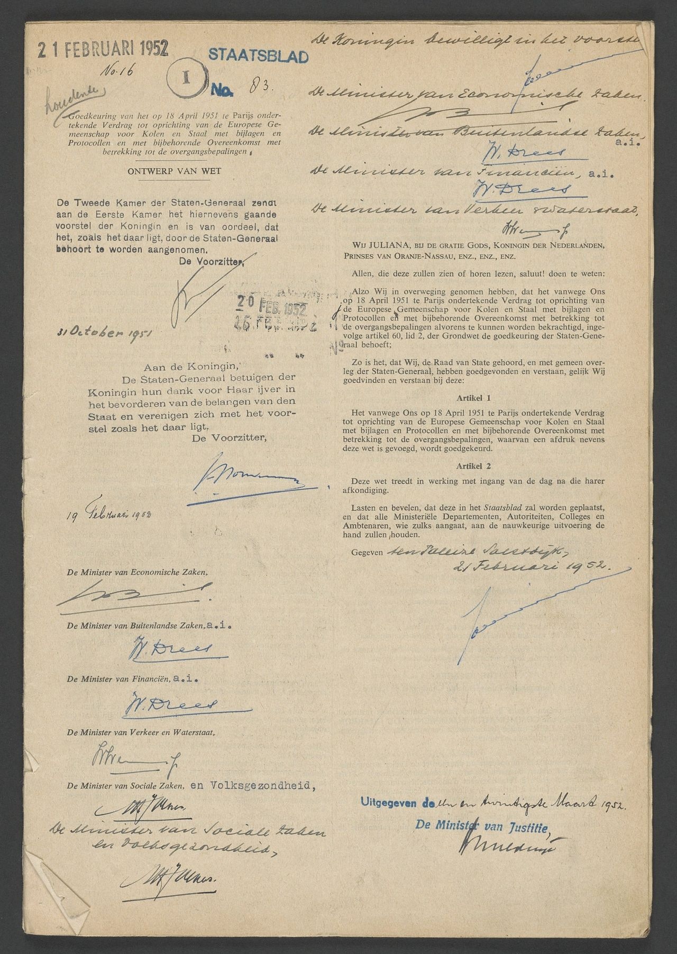

The Internal Dimension
Historical marginalization of security in integration
Legal constraints on industrial policy development (“weak” legal provisions of Articles 6(b) and 173 TFEU)
Fragmented legal framework and integration challenges
Pathway for future European integration (?)

Slide 7
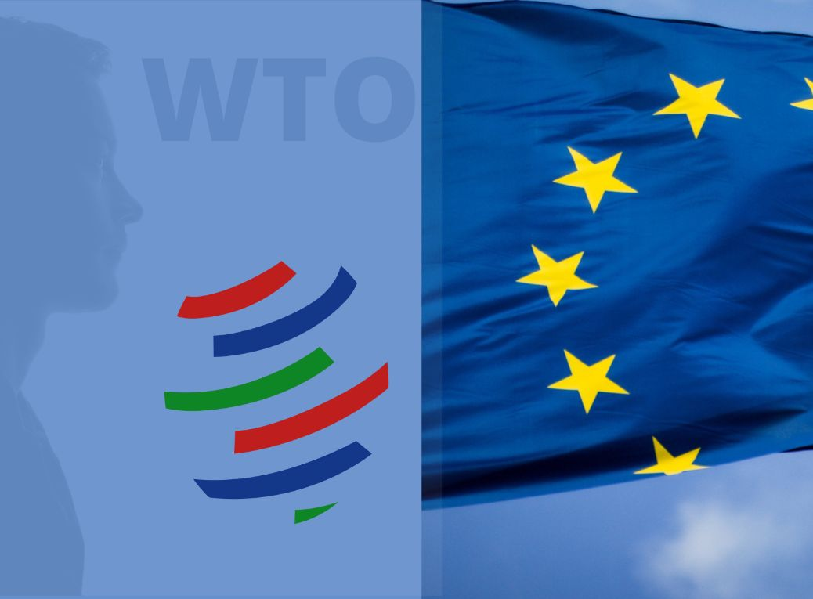
EU External Economic Security and the law
Relatively comprehensive legal framework for trade and investment (Art. 207 TFEU)
New trade (related) EU legal instruments:
  “Rigorous” use of modernized Trade Defence Instruments
  Anti-coercion Instrument
  (Revised) Foreign Direct Investment Screening / Outbound Investment Screening (?)
  Foreign Subsidies Regulation
  Tightened Export Controls

Slide 8
What does this mean for International Economic law?
Asymmetries within the economic security strategy
Facilitating role of the law in the external dimension of economic security
Law as a coercive tool for compliance
Shift towards unilateral enforcement of the multilateral regime

Slide 9

How will the EU balance its trade powers with WTO law?
OR

